Slide 1
Social Distancing Detector
Ori Zur
Northwestern University ‘22
August 10, 2020

Slide 2
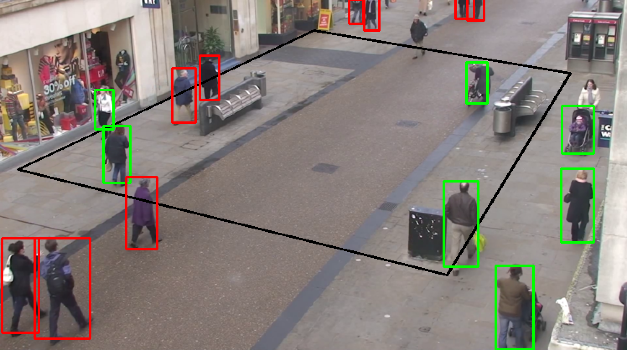
Social Distancing Detector
Detects and calculates distances between people
Indicates if distance is less than six feet

Slide 3

Sage
Array of weather and urban sensors
Utilizes “AI at the Edge”
Goal: turn my project into Sage plug-in
https://sagecontinuum.org/

Slide 4
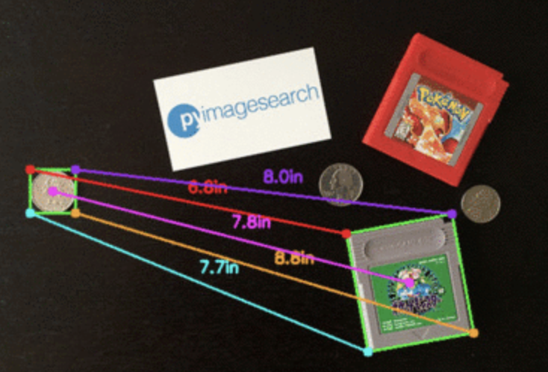
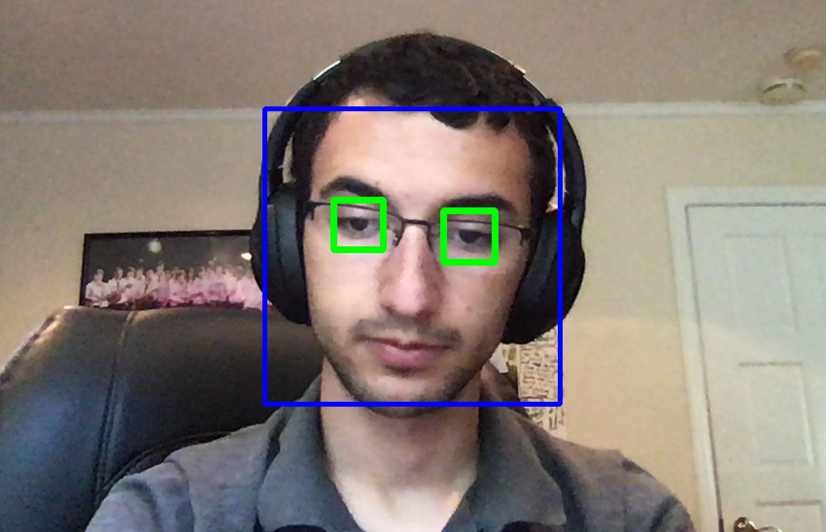
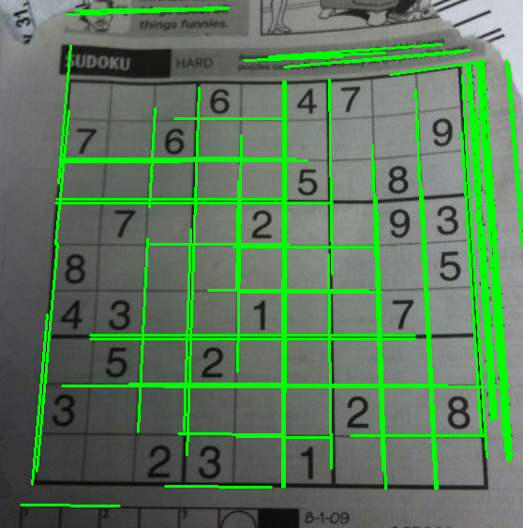
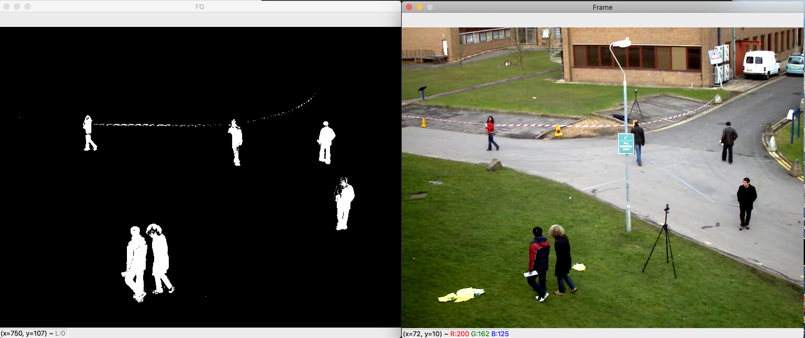
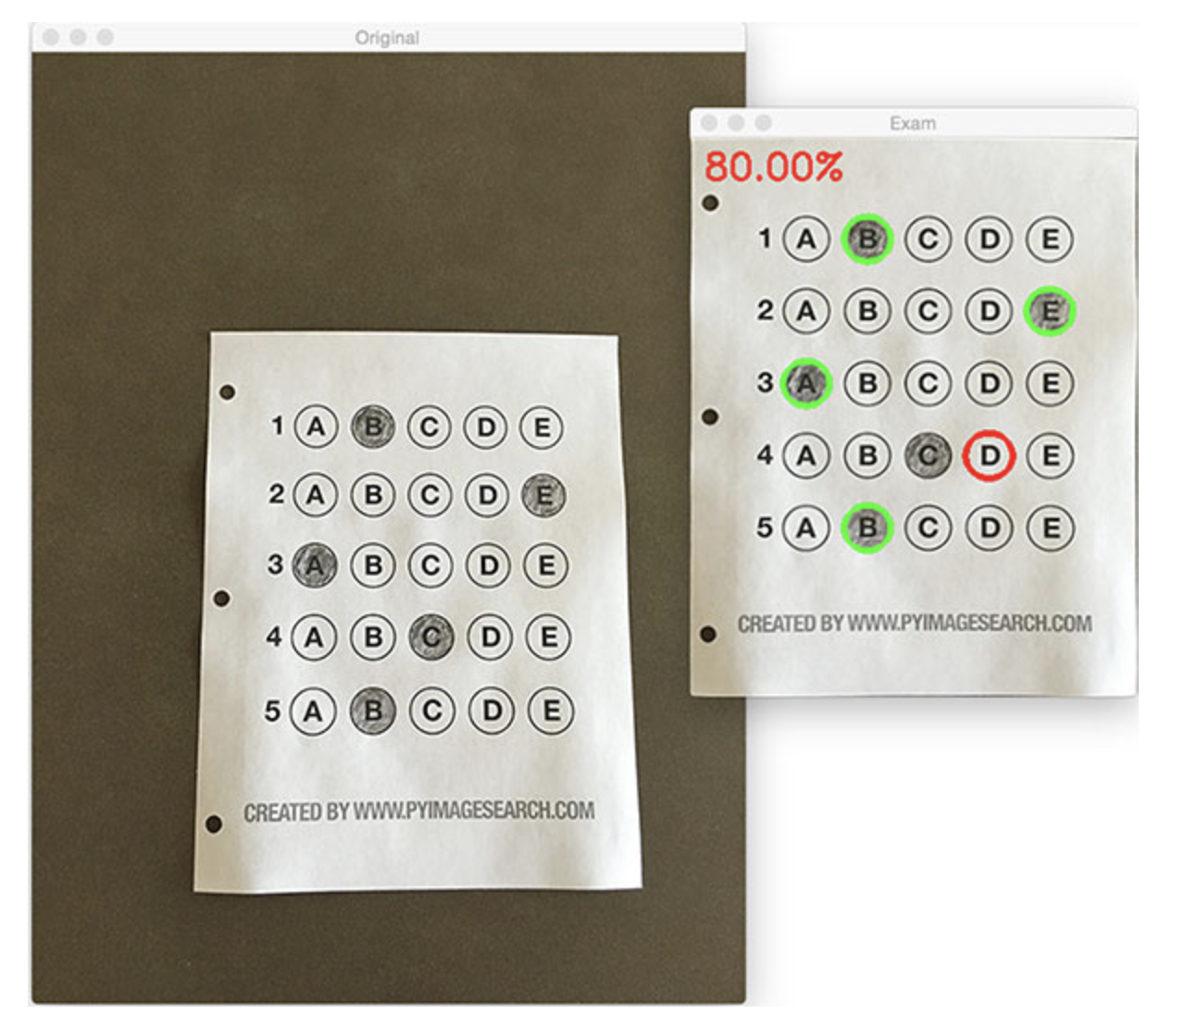
OpenCV: Functions Library for Computer Vision
https://www.pyimagesearch.com/
https://www.youtube.com/playlist?list=PLS1QulWo1RIa7D1O6skqDQ-JZ1GGHKK-K

Slide 5
Program Overview
Set Up: only happens once
Operation: loops for each frame of video

Slide 6
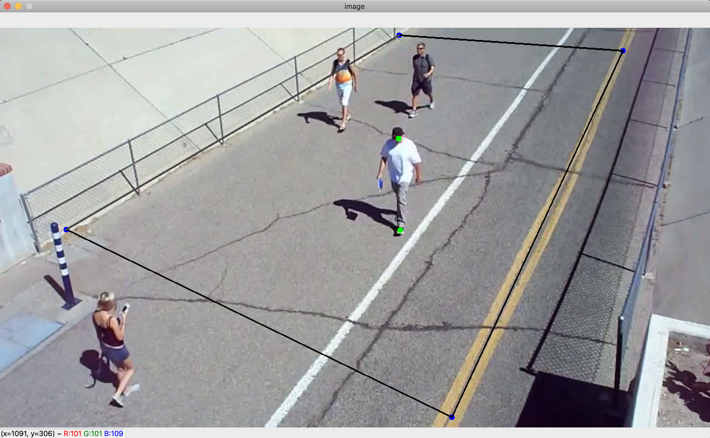
Set Up – User Inputs Mouse Points

Slide 7
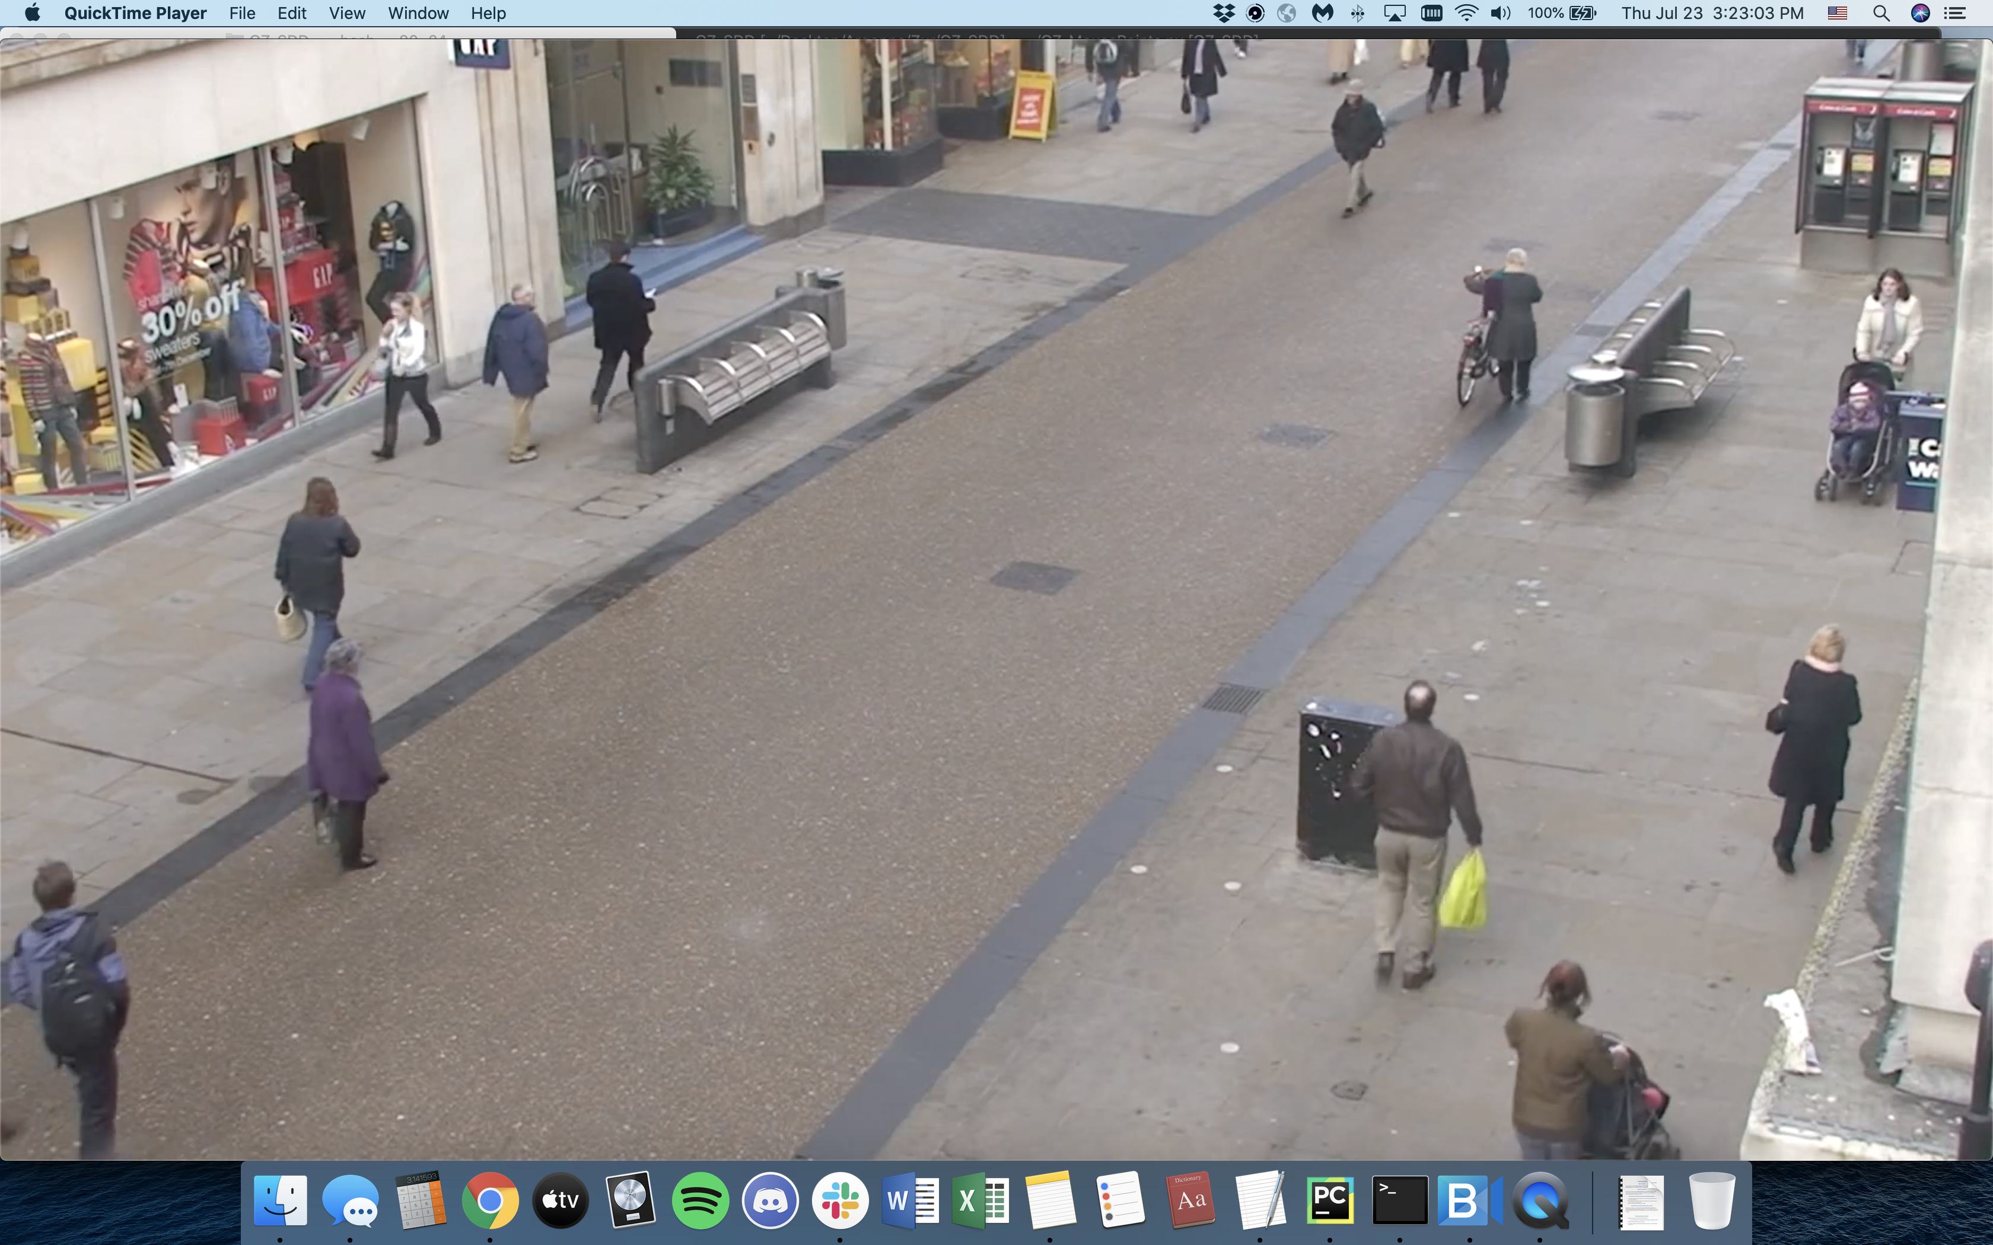
Set Up – Create Bird’s Eye View Image

Slide 8
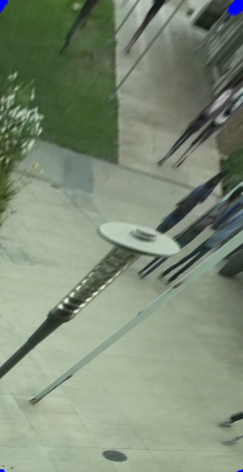
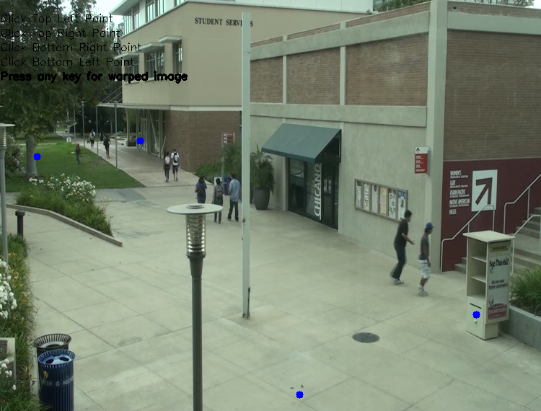
Set Up – Create Bird’s Eye View Image

Slide 9
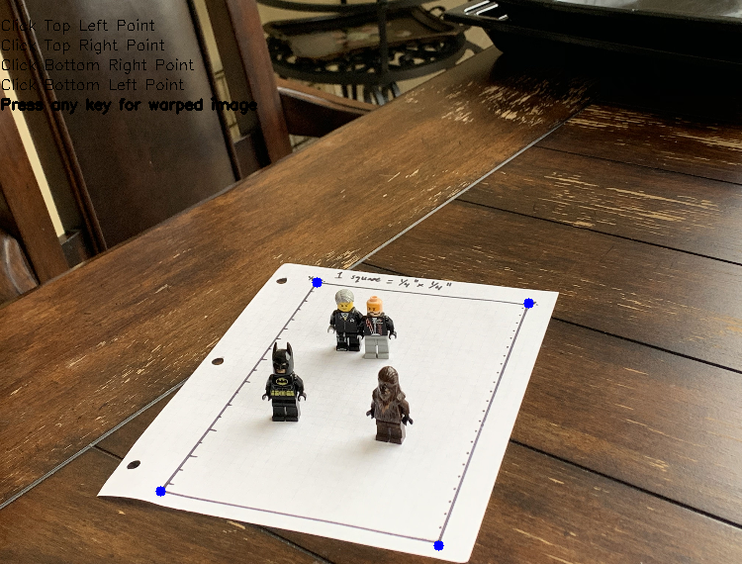
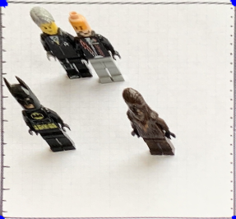
Set Up – Create Bird’s Eye View Image

Slide 10
Set Up – Calculate Minimum Safe Distance
How many pixels make up six feet?

Slide 11
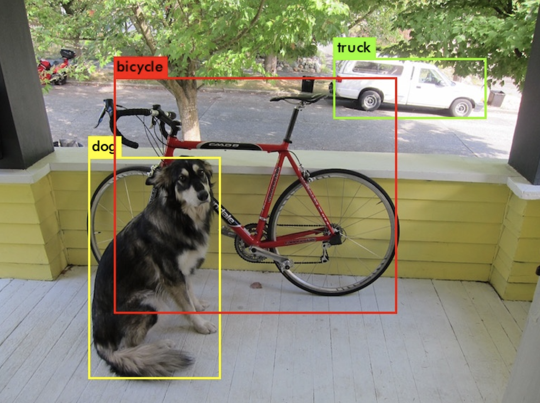
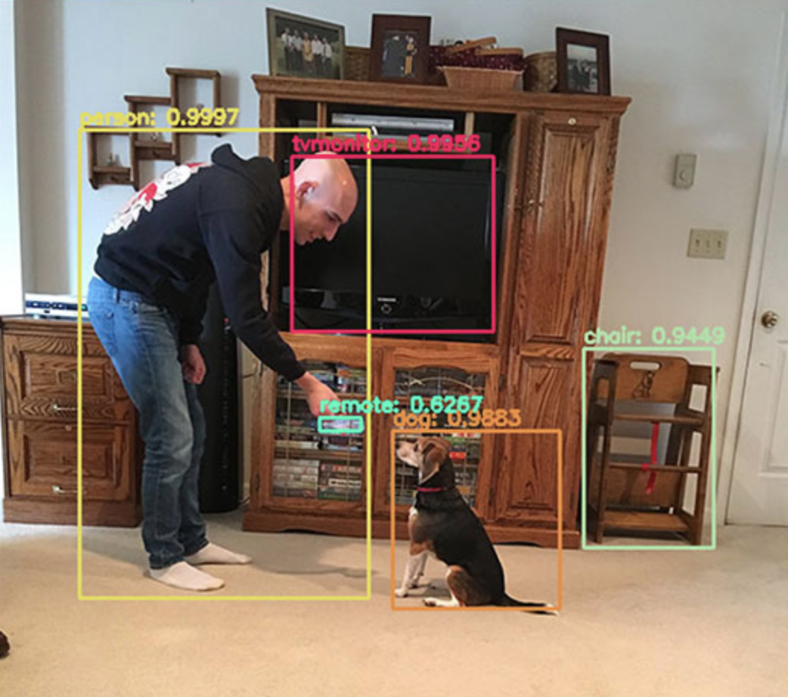
Operation– Person Detection (YOLOv3)
https://pjreddie.com/darknet/yolo/
https://www.pyimagesearch.com/2018/11/12/yolo-object-detection-with-opencv/

Slide 12
Operation– Coordinate Mapping and Distance Calculations

Slide 13
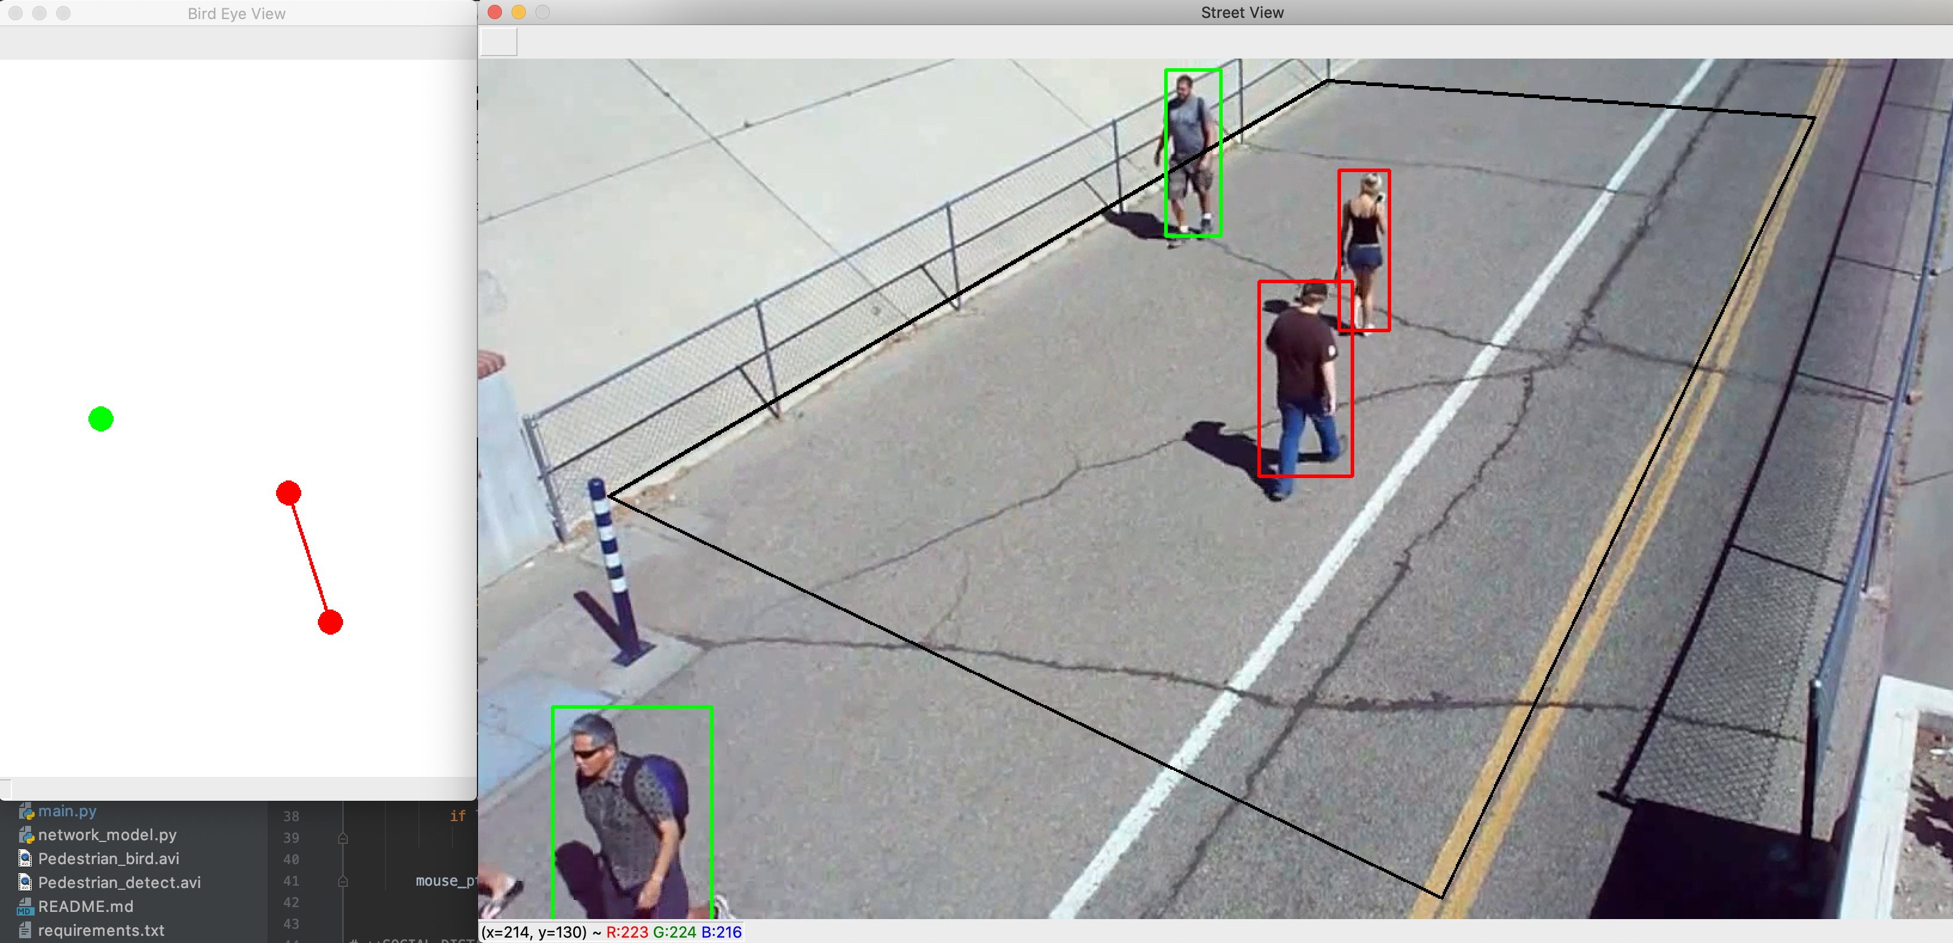
Operation – Display Current Frame

Slide 14
Program Summary Flowchart
Take video as input
User inputs 4 points for ROI, 2 points for six-foot approximation
Warp ROI into bird’s-eye-view image
Calculate min. safe distance (number of pixels that make up six feet)
Compare distances to min. safe distance, tag each pair with “safe” Boolean
Calculate distance between each pair of warped box points
Warp bounding box coordinates, map to bird’s-eye-view image
YOLO person detection, collect bounding boxes
Display bird’s eye view representation using white window and green and red circles
Indicate social distancing violations with rectangles, display street view frame
Loop to next frame

Slide 15
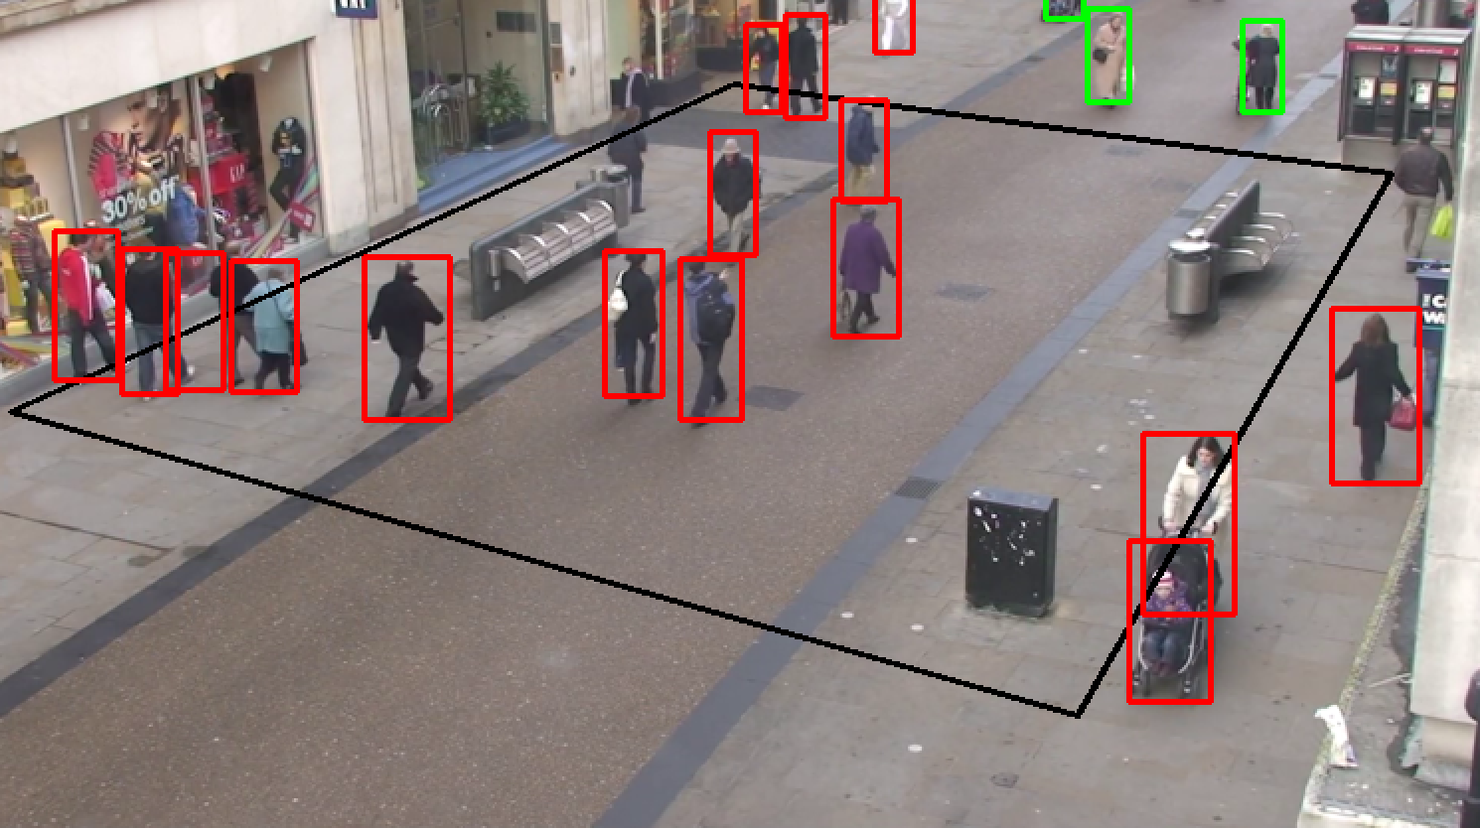
Next Steps: Groups

Slide 16
Other Applications for Human Proximity Detection
Museums
Crosswalks
https://news.artnet.com/exhibitions/timed-ticket-mona-lisa-louvre-1670233

Slide 17

Acknowledgements
Dr. Nicola Ferrier, mentor
Dr. Scott Collis, supervisor
Dr. Pete Beckman
Dr. Rajesh Sankaran
Sage Team, fellow interns
Dr. Jennifer Dunn, NAISE Team
Fellow NAISE Interns

Slide 18
Thank You
Questions?

